Slide 1
COMPUTER
PROGRAMMING
Pointers and Strings

Slide 2
Topics to be covered
Reading, writing and manipulating Strings, Understanding computer memory, accessing via pointers, pointers to arrays, dynamic allocation, drawback of pointers.

Slide 3
String definition
String is a 1-d array of characters terminated by a null (‘\0’ )
char C[] = {'A','B','C','\0'};
char S[] = "ABC";
Both C and S have length = 3
You can also have NULL instead of ‘\0’ defined in stdio.h and string.h

Slide 4
String input including blanks
main(){
char name[25] ;
printf ( "Enter name: " ) ;
scanf ( "%s", name ) ;
printf("hello %s",name);
}

Slide 5
Another way
main(){
char C[20];
gets(C); // accepts blank spaces
puts(C);
}

Slide 6
NULL and strlen()
main(){
int i=0;
char C[10];
gets(C);
while(C[i]!=NULL) printf("%c",C[i++]);
//OR while(i<strlen(C)) printf("%c",C[i++]);
}

Slide 7
Few Inbuilt functions
main( ) {
char A[] = "wxYZ", B[]="78",C[20];
printf("length of %s = %d",A,strlen(A));
if(strcmp(A,B)==0) printf("\nA,B same srings");
printf("\nC = %s",strcpy(C,A));
printf("\nUppercase of A = %s",strupr(A));
printf("\nConcat A+C = %s",strcat(C,A));
printf("\n Reverse A = %s",strrev(A));
}

Slide 8
2-d character array
char Names[6][10] = {"akshay",
"parag",
"raman"};
puts(Names[0]); //akshay

Slide 9
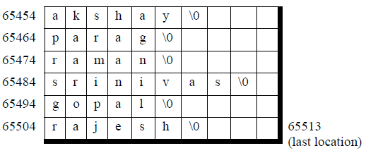
char Names[6][10] storage

Slide 10
Reading, writing and manipulating Strings, Understanding computer memory, accessing via pointers, pointers to arrays, dynamic allocation, drawback of pointers.

Slide 11
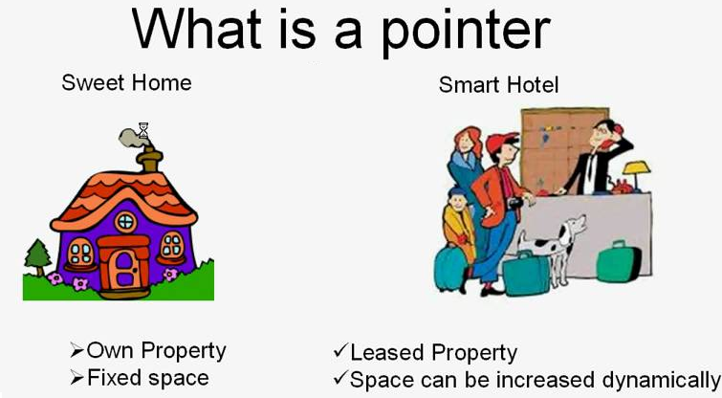
Variables vs. pointers

Slide 12
Advantages of pointers
Dynamic memory allocation
System level programming
To modify a variable in another function
Illusion of multiple returns
Passing and returning arrays

Slide 13
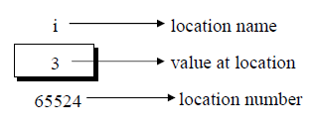
Variable, value and location

Slide 14
& - address of operator
main( ){
int i = 3 ;
printf ( "\nAddress of i = %u", &i ) ;
printf ( "\nValue of i = %d", i ) ;
}
//%u means unsigned integer, what is %p,%i,%e

Slide 15
* is value at address
main( ) {
int i = 3 ;
printf ( "\nAddress of i = %u", &i ) ;
printf ( "\nValue of i = %d", i ) ;
printf ( "\nValue of i = %d", *( &i ) ) ;
}
// output: some address, 3 and 3

Slide 16
int *j ;
This declaration tells the compiler that j will be used to store the address of an integer value.

Slide 17
Problem 1
main( ) {
int i = 3 ,*j ;
j = &i ;
printf ( "\nAddr of i = %u", &i ) ;
printf ( "\nAddr of i = %u", j ) ;
printf ( "\nAddr of j = %u", &j ) ;
printf ( "\n j = %u", j ) ; printf ( "\n i = %d", i ) ;
printf ( "\n i = %d", *( &i ) ) ; printf ( "\n i = %d", *j ) ;
}

Slide 18
Answer
Addr of i = 65524
Addr of i = 65524
Addr of j = 65522
j = 65524
i = 3
i = 3
Value of i = 3

Slide 19
Pointers for other datatypes
int *alpha ;
char *ch ;
float *s ;
Pointers are variables that contain addresses, and since addresses are whole numbers, pointers would always contain whole numbers.

Slide 20
char *ch ;
*ch will contain a character
ch is an unsigned int containing the address

Slide 21
Problem 2
main(){
inti=3,*j,**k;
j=&i; k=&j;
printf("\naddr of i=%u",&i);
printf("\naddr of i=%u",j);
printf("\naddr of i=%u",*k);
printf("\naddr of j=%u",&j);
printf("\naddr of j=%u",k);
printf("\naddr of k=%u",&k);
printf("\nj=%u",j); printf("\nk=%u",k);
printf("\ni=%d",i); printf("\ni=%d",*(&i));
printf("\ni=%d",*j); printf("\ni=%d",**k);
}

Slide 22
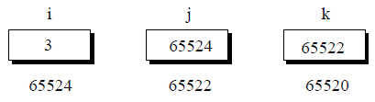
Situation

Slide 23
Answer
addr of i=6487628
addr of i=6487628
addr of i=6487628
addr of j=6487616
addr of j=6487616
addr of k=6487608
j=6487628
k=6487616
i=3
i=3
i=3
i=3

Slide 24
Problem 3
main() {
int Var = 10;
int *ptr = &Var;
printf("Var = %d\n", *ptr);
printf("Var Addr = %u\n", ptr);
*ptr = 20;
printf("Var = %d\n", Var);
}

Slide 25
Answer
Var = 10
Var Addr = 6487620
Var = 20

Slide 26
Problem 4
main() {
int v[3] = {10, 100, 200},i;
int *ptr;
ptr = v;
for(i = 0; i < 3; i++) {
printf("*ptr = %d\n", *ptr);
printf("ptr = %u\n", ptr);
ptr++;
}
}

Slide 27
Answer
*ptr = 10
ptr = 6487600
*ptr = 100
ptr = 6487604
*ptr = 200
ptr = 6487608

Slide 28
Problem 5
main( ) {
int i=3,*x; float j=1.5,*y; char k='c',*z ;
printf("\n i=%d, j=%f, k=%c",i,j,k) ;
x = &i ; y = &j ; z = &k ;
printf("\n Addr of x,y,z = %u, %u, %u",x,y,z);
x++; y++; z++;
printf("\n New Addr of x,y,z = %u, %u, %u",x,y,z);
}

Slide 29
Answer
i=3, j=1.500000, k=c
Addr of x,y,z = 6487604, 6487600, 6487599
New Addr of x,y,z = 6487608, 6487604, 6487600

Slide 30



Problem 6
main( ) {
int arr[] = { 10, 20, 30, 45, 67, 56, 74 };
int *i, *j;
i = &arr[1]; j = &arr[5];
printf("%d %d", j-i, *j-*i);
}

Slide 31
Answer
4 36

Slide 32
Problem 7
main(){
int arr[]={10,20,36,72,45,36};
int*j,*k;
j=&arr[4];
k=(arr+4);
if(j==k)
printf("Same locations");
else printf("Different locations");
}

Slide 33
Answer
Same locations

Slide 34
























Problem 8
main(){
int a = 10, b = 20 ;
swapv ( a, b ) ;
printf ( "\na = %d b = %d", a, b ) ;
}
swapv ( int x, int y ) {
int t = x ;
x = y ; y = t ;
printf ( "\nx = %d y = %d", x, y ) ;
}

Slide 35
Answer
x = 20 y = 10
a = 10 b = 20

Slide 36
Problem 9: Pointer swap
main( ) {
int a = 10, b = 20 ;
swapr ( &a, &b ) ;
printf ( "\na = %d, b = %d", a, b ) ;
}
swapr( int *x, int *y ) {
int t = *x ; *x = *y ; *y = t ;
}

Slide 37
Problem 10: One * for 1-d
main( ) {
int a[3]={1,2,3},*b,i;
b=a;
for(i=0;i<3;i++) {
printf("\n %d %d",a[i],b[i]);
}}

Slide 38
Output
1 1
2 2
3 3

Slide 39
Problem 11: Multiple returns
AreaPeri(int r, float *A, float *P){
*A = 3.14*r*r; *P = 2*3.14*r;
}
main( ){
int r; float A,P;
printf("\nEnter radius: " ); scanf("%d",&r);
AreaPeri(r,&A,&P); printf("Area = %f, Peri = %f",A,P);
}

Slide 40
Same things
name[i]
*( name + i )
*( i + name )
i[name]

Slide 41
Problem 12: Array vs *
main( ){
char A[] = "Hello", B[10] ;
char *C = "Good Morning", *D;
//B = A ; /* error */
D = C ; /* Okay */
printf("%s",D);
} // cannot assign array to array, but can assign pointer to pointer

Slide 42
Problem 13: * are dynamic
main( ) {
char A[] = "Hello" ;
char *B = "Hello" ;
//A = "Bye" ; /* error */
B = "Bye" ; /* works */
printf("%s",B);
}

Slide 43







Problem 14: Returning an array
int *incr(int X[3],int k){
int i;
for(i=0;i<k;i++) ++X[i];
return X;
}
main(){
int A[] = {1,2,3},n=3,i,*B;
B = incr(A,n);
for(i=0;i<n;i++) printf(" %d",B[i]);
}

Slide 44
Output
2 3 4

Slide 45
Array of pointers
char*names[]={"akshay","parag","raman","srinivas", "gopal","rajesh"};
It contains base address of various names

Slide 46
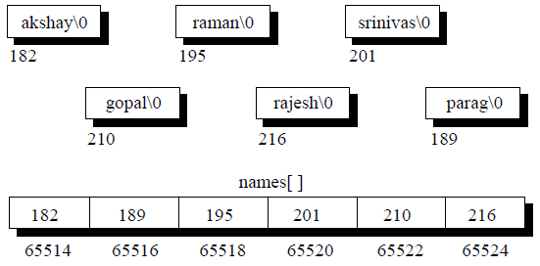
Array of pointers

Slide 47
Problem 15: Dynamic allocation
main(){
int *ptr, n,i;
printf("Size of array? "); scanf("%d",&n);
ptr = (int*)malloc(n*sizeof(int));
for(i=0;i<n;i++) ptr[i]=i;
for(i=0;i<n;i++) printf(" %d",ptr[i]);
free (ptr);
}

Slide 48
Output
Size of array? 10
0 1 2 3 4 5 6 7 8 9

Slide 49
Drawback of pointers
Complicated to use and debug
Uninitialized pointers might cause segmentation fault
Dynamically allocated block needs to be freed explicitly. Otherwise, it would lead to memory leak (occupied but unused memory)
If pointers are updated with incorrect values, it might lead to memory corruption

Slide 50
Topics covered were
Reading, writing and manipulating Strings,
Understanding computer memory, accessing via pointers, pointers to arrays, dynamic allocation, drawback of pointers.

